Slide 1
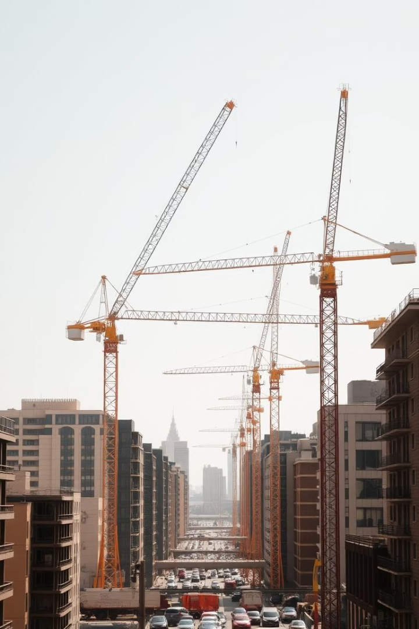
Construction Cranes: A Visual Overview
Explore the powerful machines that shape our skylines. This presentation covers key crane types, components, and innovations. Get ready for a visually rich journey through crane technology.

Slide 2
Types of Cranes: Tower Cranes in Action
Tower Cranes
Typical Uses
Fixed to the ground or building, tallest cranes on site.
Ideal for urban construction and large-scale projects.
Used for heavy lifting at height
Concrete placement
Support building skyscrapers
Steel frame assembly
Long horizontal jib for reach
Material transport over long distances

Slide 3
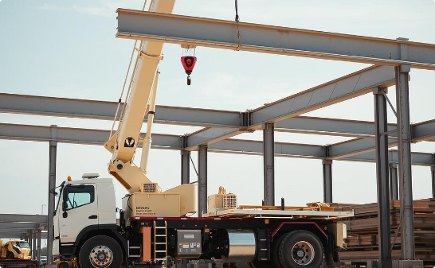
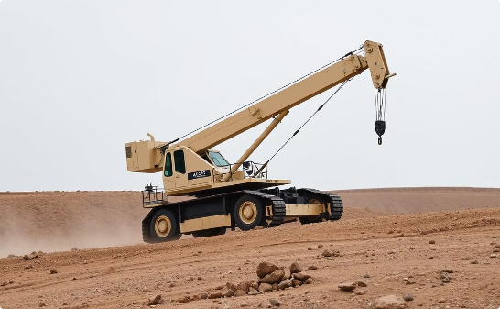
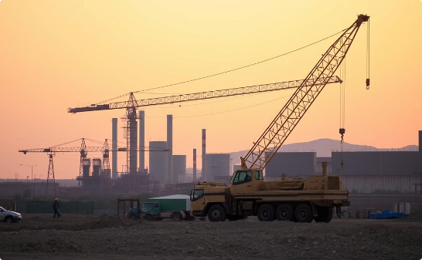
Mobile Cranes: Versatility on Site
Truck-Mounted
Crawler Crane
Rough Terrain Crane

Slide 4
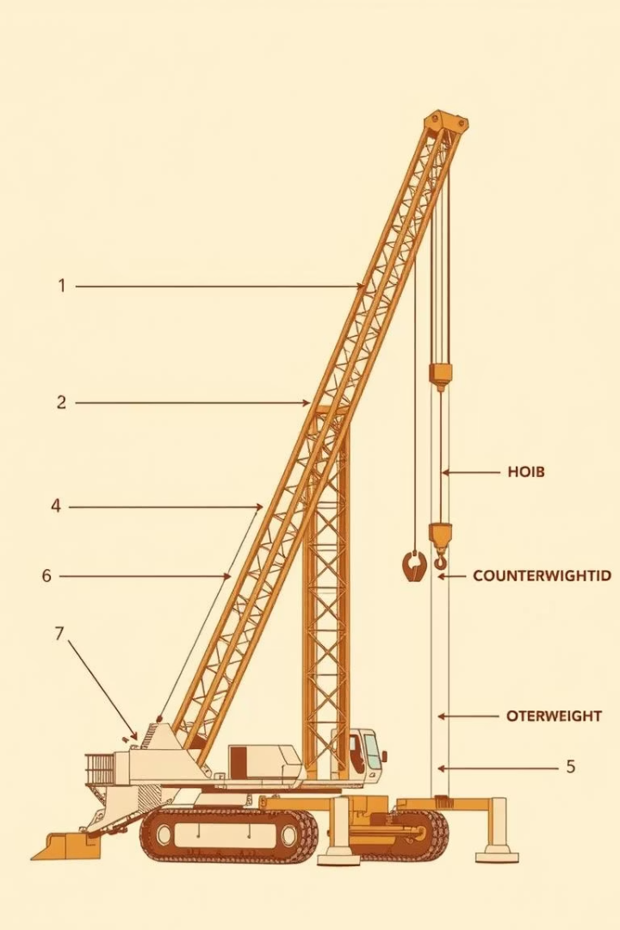

Crane Components: Boom, Jib, Counterweights
Boom
Jib
The main lifting arm extending from the crane base.
Extension at the end of the boom for extra reach.
Counterweights
Balance the crane to prevent tipping during lifts.

Slide 5
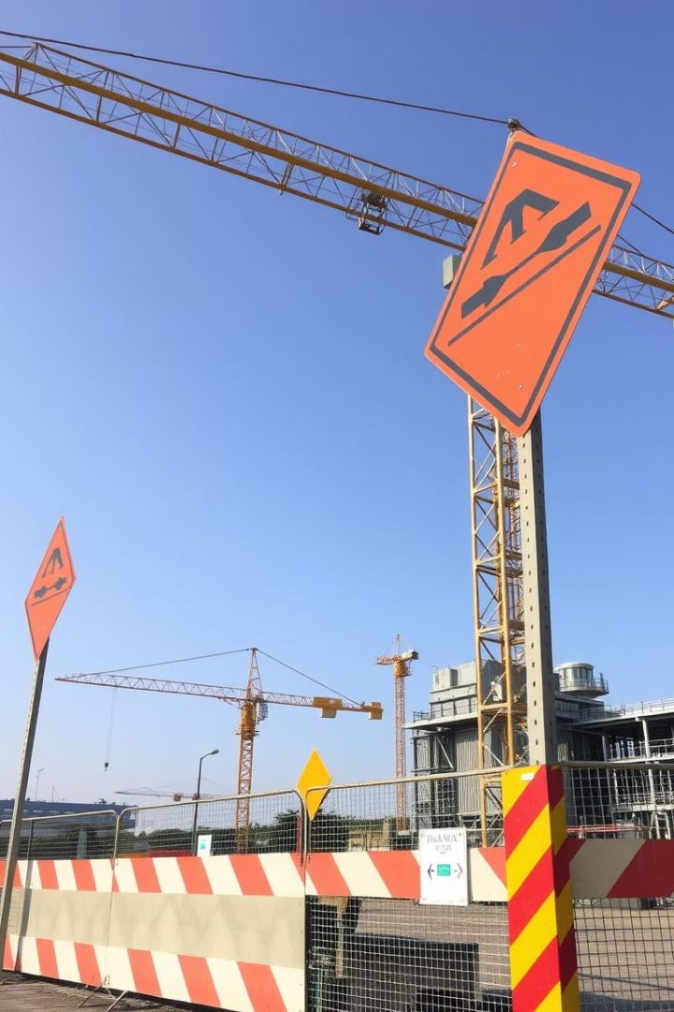
Safety Measures
Operator Training
Certified training ensures skilled, safe operation.
Load Limits
Never exceed the rated lifting capacity.
Site Inspection
Regular checks of ground stability and crane condition.
Communication
Clear signals and radios prevent accidents.

Slide 6
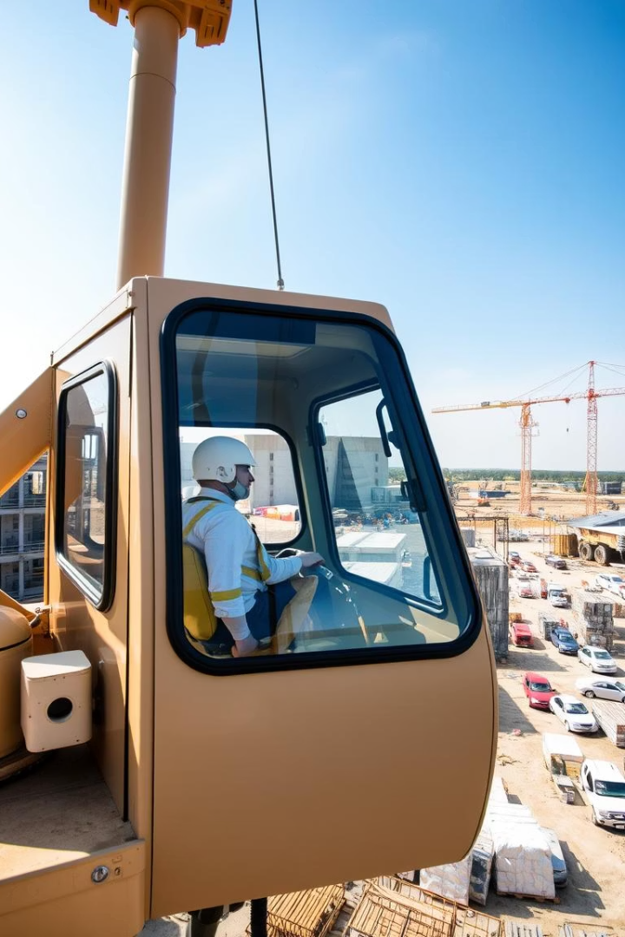



Crane Operation: Lifting, Moving, and Placing Loads
Lifting
Attach load securely and lift smoothly.
Moving
Swing boom or move crane carefully to position.
Placing
Lower load precisely to its destination.

Slide 7
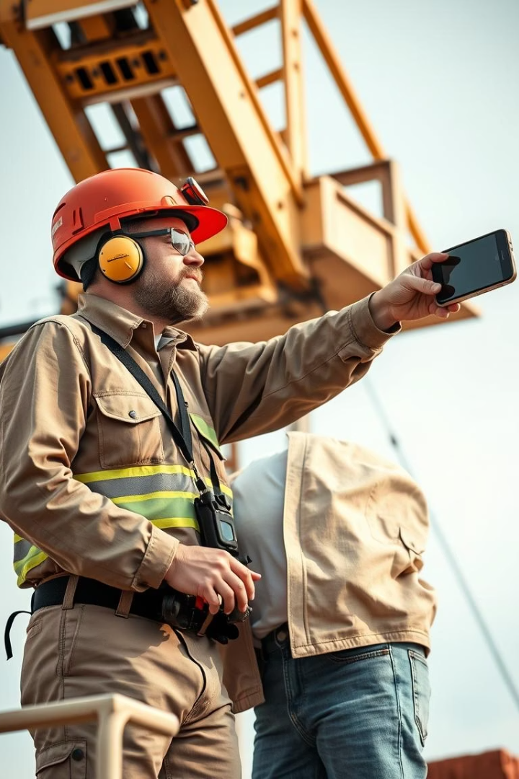




Crane Signals: Standard Hand Signals
Stop
Hoist
Lower
Flat hand held out, palm facing operator.
Fist with thumb up, signaling lift the load.
Fist with thumb down, signaling lower the load.
Swing
Arm extended, moving in desired swing direction.

Slide 8
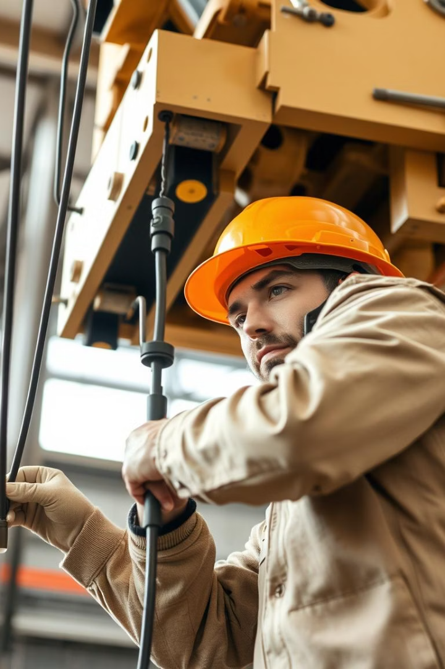
Crane Maintenance: Ensuring Optimal Performance
Daily Inspections
Check cables, controls, and brakes before use.
Lubrication
Keep moving parts well-oiled to avoid wear.
Structural Checks
Inspect welds and metal fatigue regularly.
Repairs
Address defects immediately to maintain safety.

Slide 9




Innovations in Crane Technology
Automation
Remote Control
1
Robotics reduce human error and increase efficiency.
Operators can control cranes safely from distance.
2
Energy Efficiency
4
Smart Sensors
Electric and hybrid cranes reduce environmental impact.
3
Real-time data boosts safety and performance monitoring.

Slide 10

The Future of Cranes: Smarter, Safer, Stronger
Sustainability Focus
Enhanced Connectivity
Cleaner energy and recycling reduce footprint.
Advanced Materials
AI Integration
Stronger, lighter materials increase load capacity.
Networked cranes improve coordination on complex sites.
Intelligent systems optimize lifting and safety.

